Slide 1
Subject: SOFTWARE ENGINEERING Subject Code: 3CS4-07 UNIT II: Software PROJECT MANAGEMENT
GLOBAL INSTITUTE OF TECHNOLGY JAIPUR
Software Engineering
III SEM CS

Slide 2
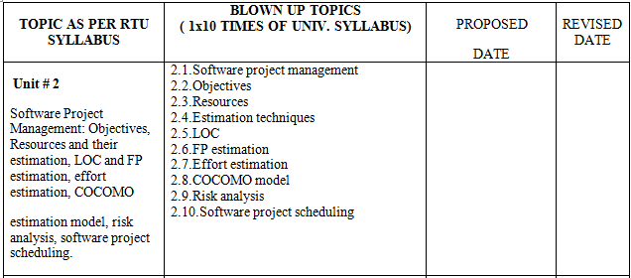
SUBJECT BLOWN AND RECOMMENDED BOOKS: T1 :- “Software Engineering” Roger S. Pressman, TMH, sixth edition. T2 :- “Software Engineering Fundamentals” Ali Behforooz and Frederick J. Hudson,(2nd ed.”) T3 :- “Software requirements” Karl E. Wiegers

Slide 3
INTRODUCTION TO Software PROJECT MANAGEMENT

Slide 4
OBJECTIVES
The objective of software project planning is to provide a framework that enables the manager to make reasonable estimates of resources, cost, and schedule.
These estimates are made within a limited time frame at the beginning of a software project and should be updated regularly as the project progresses.
In addition, estimates should attempt to define best case and worst case scenarios so that project outcomes can be bounded.
The planning objective is achieved through a process of information discovery that leads to reasonable estimates.
In the following slides, each of the activities associated with software project planning is discussed.

Slide 5
What is a project?
A project is a temporary endeavor undertaken to produce a unique product or service
What are the differences between projects and operations?
Characteristics of Operations
Ongoing – Continuous cycle
Repetitive – Expected inputs and outputs
Characteristics of Projects
Temporary – Definitive beginning and end
Unique – New undertaking, unfamiliar ground
Notes:
A Project is a unique undertaking so the approach to managing projects must be different compared to operations.

Slide 6
What is a successful project?
Customer Requirements satisfied/exceeded
Completed within allocated time frame
Completed within allocated budget
Acceptance by the customer

Slide 7
Why do projects fail?
Poor requirements gathering
No Functional input in planning
Unrealistic planning and scheduling/Impossible schedule commitments
Lack of resources
Notes:
90% of Projects run over budget or schedule due to scope creep
70% of projects fail due to poor requirements gathering

Slide 8
What is Project Management?
Project Management is the application of skills, knowledge, tools and techniques to meet the needs and expectations of stakeholders for a project
The purpose of project management is prediction and prevention, NOT recognition and reaction
Effective Management of the Triple Constraints
Requirements – Needs Identified or Unidentified Expectations
Cost/Resources – People, Money, Tools
Schedule/Time

Slide 9
Key areas of Project Management
Scope Management
Issue Management
Cost Management
Quality Management
Communications Management
Risk Management
Change Control Management
Notes:
SCOPE MANAGEMENT – Ensuring all the appropriate work within the project scope is completed and only the work within scope is being conducted
TIME MANAGEMENT – Schedule Management
COST MANAGEMENT – How costs are controlled and incurred costs are paid
QUALITY MANAGEMENT – Quality Assurance Plan – How quality control is measured and satisfied
HUMAN RESOURCE MANAGEMENT – Development of the project team, reporting structure, resource capacity
COMMUNICATIONS MANAGEMENT – How project communications will be handled to ensure all project stakeholders are informed
RISK MANAGEMENT – Risk Management plan to have all project stakeholders in agreement on how project risks will be handled (aversion, mitigation or assumption)
PROCUREMENT MANAGEMENT – Procurement process, contract processes
INTEGRATION MANAGEMENT – Integration of all areas of project management to develop a cohesive project plan

Slide 10
Scope Management
Project Scope Management is the process to ensure that the project is inclusive of all the work required, and only the work require, for successful completion.
Primarily it is the definition and control of what IS and IS NOT included in the project
This component is used to communicate
How the scope was defined
How the project scope will be managed
Who will manage the scope (e.g., PM, QA)
Change Control

Slide 11
Issue Management
Issues are restraints to accomplishing the deliverables of the project.
Issues are typically identified throughout the project and logged and tracked through resolution.
Issues not easily resolved are escalated for resolution.
In this section of the plan the following processes are depicted:
Where issues will be maintained and tracked
The process for updating issues regularly
The escalation process

Slide 12
Cost Management
The processes required to ensure the project is completed within the approved budget and includes:
Resource Planning - The physical resources required (people, equipment, materials) and what quantities are necessary for the project
Full Time Employees, Professional Services, Cost, and Contingency
Budget -
Budget estimates
Baseline estimates
Project Actuals

Slide 13
Quality Management
Quality Management is the processes that insure the project will meet the needs via:
Quality Planning, Quality Assurance, and Quality Control
Clearly Defined Quality Performance Standards
How those Quality and Performance Standards are measured and satisfied
How Testing and Quality Assurance Processes will ensure standards are satisfied
Continuous ongoing quality control

Slide 14
Communications Management
The processes necessary to ensure timely and appropriate generation, collection, dissemination, and storage of project information using:
Communications planning:
Determining the needs (who needs what information, when they need it, and how it will be delivered)
Information Distribution:
Defining who and how information will flow to the project stakeholders and the frequency
Performance Reporting:
Providing project performance updates via status reporting.
Define the schedule for the Project Meetings (Team, OSC, ESC), Status Meetings and Issues Meetings to be implemented

Slide 15
Risk Management
Risk identification and mitigation strategy
When\if new risks arise
Risk update and tracking

Slide 16
Change Control Management
Define how changes to the projects scope will be executed
Formal change control is required for all of the following:
Scope Change
Schedule changes
Technical Specification Changes
Training Changes
All changes require collaboration and buy in via the project sponsor’s signature prior to implementation of the changes

Slide 17
We have discussed………..
What is a project
What is a successful project
Why do project fails
what is the project management
Key areas of Project Management

Slide 18
Sample Project Life Cycle
Initiation Phase
Definition Phase
Planning Phase
Implementation Phase
Deployment Phase
Closing Phase

Slide 19
Initiation Phase
Define the need
Return on Investment Analysis
Make or Buy Decision
Budget Development

Slide 20
Definition Phase
Define Project Scope
Define functional requirements
Requirements to be prioritized into business critical and non-business critical need
Define technical requirements
Risk Management Planning

Slide 21
Planning Phase
Resource Planning
Work Breakdown Structure
Project Schedule Development
Configuration Management Plan
Quality Assurance Plan
Production Support Plan
Service Level Agreement
System Design

Slide 22
Implementation Phase
Training Plan
System Build
Quality Assurance

Slide 23
Deployment Phase
User Training
Production Review
Go Live

Slide 24
Closing Phase
Contractual Closeout
Post Production Transition
Lessons Learned

Slide 25
Skills necessary for software project management
A theoretical knowledge of different project management techniques
Good qualitative judgment and decision taking capabilities.
Good communication skills and the ability get work done.
Skills for tracking and controlling the progress of the project, customer interaction, managerial presentations, and team building

Slide 26
Responsibilities of a software project manager
Software project managers take the overall responsibility of steering a project to success.
Project proposal writing,
Project cost estimation,
Scheduling,
Project staffing,
Software process tailoring,
Project monitoring and control,
Software configuration management,
Risk management,
Interfacing with clients,
Managerial report writing and presentations, etc.

Slide 27
Responsibilities of a software project manager
Activities can be broadly classified:
1. project planning, 2. project monitoring and control activities.
The project planning activity is undertaken before the development starts to plan the activities to be undertaken during development.
The project monitoring and control activities are undertaken once the development activities start with the aim of ensuring that the development proceeds as per plan and changing the plan whenever required to cope up with the situation.

Slide 28
Project planning
Project planning is undertaken and completed even before any development activity starts.
Project planning consists of the following essential activities:
Estimating the following attributes of the project:
Project size: What will be problem complexity in terms of the effort and time required to develop the product?
Cost: How much is it going to cost to develop the project?
Duration: How long is it going to take to complete development?
Effort: How much effort would be required?

Slide 29
The effectiveness of the subsequent planning activities is based on the accuracy of these estimations.
Scheduling manpower and other resources
Staff organization and staffing plans
Risk identification, analysis, and abatement planning
Miscellaneous plans such as quality assurance plan, configuration management plan, etc.

Slide 30
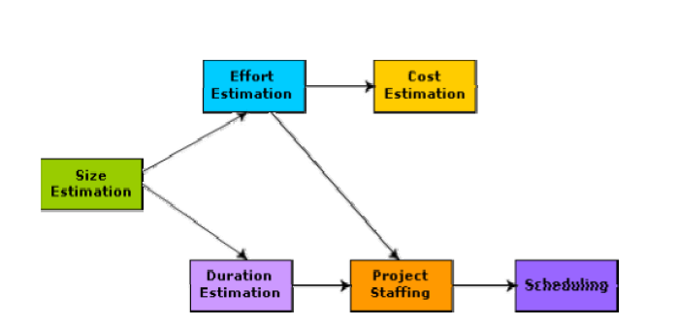
Precedence ordering among project planning activities

Slide 31
Software Project Management Plan (SPMP)
Once project planning is complete, project managers document their plans in a Software Project Management Plan (SPMP) document.
Organization of the Software Project Management Plan (SPMP) Document
1.Introduction
(a) Objectives
(b) Major Functions
(c) Performance Issues
(d) Management and Technical Constraints

Slide 32
2. Project Estimates
(a) Historical Data Used
(b) Estimation Techniques Used
(c) Effort, Resource, Cost, and Project Duration Estimates
3. Schedule
(a) Work Breakdown Structure
(b) Task Network Representation
(c) Gantt Chart Representation
(d) PERT Chart Representation

Slide 33
4. Project Resources
(a) People
(b) Hardware and Software
(c) Special Resources
5. Staff Organization
(a) Team Structure
(b) Management Reporting
6. Risk Management Plan
(a) Risk Analysis
(b) Risk Identification
(c) Risk Estimation
(d) Risk Abatement Procedures

Slide 34
7. Project Tracking and Control Plan
8. Miscellaneous Plans
(a) Process Tailoring
(b) Quality Assurance Plan
(c) Configuration Management Plan
(d) Validation and Verification
(e) System Testing Plan
(f) Delivery, Installation, and Maintenance Plan

Slide 35
We have discussed in last lecture
What is a project
What is a successful project
Why do project fails
what is the project management
Key areas of Project Management

Slide 36
four P's with respect to software Project Management
i) Product
ii) People
iii) Process
iv) Project

Slide 37
product
Product is any package that is developed to deliver to a customer for solving some problem.
To develop successful product, before a software project is planned product’s objectives and scope need to be established,
various solutions need to be thought of, and technical and management constraints need to be known.

Slide 38
people
The following categories of people (stackholders) are involved in the software process.
Senior Managers
Project Managers
Practitioners
Customers
End Users

Slide 39
process
Process is the set of Umbrella activities or framework activities, which occur throughout the process.
Here the important thing is to select an appropriate process model to develop the software.
There are different process models available.
Water fall model,
Iterative water fall model,
Prototyping model,
Evolutionary model,
RAD(Rapid Application Development) model,
Spiral model.
In practice we may use any one of the above models or a combination of the above models.

Slide 40
project
The project contains all and everything of the entire development method and to avoid project failure the manager needs to take some steps.
In order to manage a successful software project, we must understand what can go wrong (so that problems can be Avoided)and how to do it right.
A project is a series of steps where we need to make accurate decision so as to make a successful project.

Slide 41
Sample Project Life Cycle
Initiation Phase
Definition Phase
Planning Phase
Implementation Phase
Deployment Phase
Closing Phase

Slide 42
Initiation Phase
Define the need
Return on Investment Analysis
Make or Buy Decision
Budget Development

Slide 43
Definition Phase
Define Project Scope
Define functional requirements
Requirements to be prioritized into business critical and non-business critical need
Define technical requirements
Risk Management Planning

Slide 44
Planning Phase
Resource Planning
Work Breakdown Structure
Project Schedule Development
Configuration Management Plan
Quality Assurance Plan
Production Support Plan
Service Level Agreement
System Design

Slide 45
Implementation Phase
Training Plan
System Build
Quality Assurance

Slide 46
Deployment Phase
User Training
Production Review
Go Live

Slide 47
Closing Phase
Contractual Closeout
Post Production Transition
Lessons Learned

Slide 48
Skills necessary for software project management
A theoretical knowledge of different project management techniques
Good qualitative judgment and decision taking capabilities.
Good communication skills and the ability get work done.
Skills for tracking and controlling the progress of the project, customer interaction, managerial presentations, and team building

Slide 49
Responsibilities of a software project manager
Software project managers take the overall responsibility of steering a project to success.
Project proposal writing,
Project cost estimation,
Scheduling,
Project staffing,
Software process tailoring,
Project monitoring and control,
Software configuration management,
Risk management,
Interfacing with clients,
Managerial report writing and presentations, etc.

Slide 50
Responsibilities of a software project manager
Activities can be broadly classified:
1. project planning, 2. project monitoring and control activities.
The project planning activity is undertaken before the development starts to plan the activities to be undertaken during development.
The project monitoring and control activities are undertaken once the development activities start with the aim of ensuring that the development proceeds as per plan and changing the plan whenever required to cope up with the situation.

Slide 51
Project planning
Project planning is undertaken and completed even before any development activity starts.
Project planning consists of the following essential activities:
Estimating the following attributes of the project:
Project size: What will be problem complexity in terms of the effort and time required to develop the product?
Cost: How much is it going to cost to develop the project?
Duration: How long is it going to take to complete development?
Effort: How much effort would be required?

Slide 52
The effectiveness of the subsequent planning activities is based on the accuracy of these estimations.
Scheduling manpower and other resources
Staff organization and staffing plans
Risk identification, analysis, and abatement planning
Miscellaneous plans such as quality assurance plan, configuration management plan, etc.

Slide 53
Precedence ordering among project planning activities

Slide 54
Software Project Management Plan (SPMP)
Once project planning is complete, project managers document their plans in a Software Project Management Plan (SPMP) document.
Organization of the Software Project Management Plan (SPMP) Document
1.Introduction
(a) Objectives
(b) Major Functions
(c) Performance Issues
(d) Management and Technical Constraints

Slide 55
2. Project Estimates
(a) Historical Data Used
(b) Estimation Techniques Used
(c) Effort, Resource, Cost, and Project Duration Estimates
3. Schedule
(a) Work Breakdown Structure
(b) Task Network Representation
(c) Gantt Chart Representation
(d) PERT Chart Representation

Slide 56
4. Project Resources
(a) People
(b) Hardware and Software
(c) Special Resources
5. Staff Organization
(a) Team Structure
(b) Management Reporting
6. Risk Management Plan
(a) Risk Analysis
(b) Risk Identification
(c) Risk Estimation
(d) Risk Abatement Procedures

Slide 57
7. Project Tracking and Control Plan
8. Miscellaneous Plans
(a) Process Tailoring
(b) Quality Assurance Plan
(c) Configuration Management Plan
(d) Validation and Verification
(e) System Testing Plan
(f) Delivery, Installation, and Maintenance Plan

Slide 58
RESOURCES AND THEIR ESTIMATION LOC and FP estimation

Slide 59
RESOURCES

Slide 60
RESOURCES
The second software planning task is estimation of the resources required to accomplish the software development effort.
Figure in previous slide illustrates development resources as a pyramid.
The development environment—hardware and software tools—sits at the foundation of the resources pyramid and provides the infrastructure to support the development effort.
At a higher level, we encounter reusable software components— software building blocks that can dramatically reduce development costs and accelerate delivery.

Slide 61
At the top of the pyramid is the primary resource—people.
Each resource is specified with four characteristics:
description of the resource,
a statement of availability,
time when the resource will be required;
duration of time that resource will be applied.
The last two characteristics can be viewed as a time window.
Availability of the resource for a specified window must be established at the earliest possible time.

Slide 62
HUMAN RESOURCES
The planner begins by evaluating scope and selecting the skills required to complete development.
Both organizational position (e.g., manager, senior software engineer) and specialty (e.g., telecommunications, database, client/server) are specified.
For relatively small projects (one person-year or less), a single individual may perform all software engineering tasks, consulting with specialists as required.
The number of people required for a software project can be determined only after an estimate of development effort (e.g., person-months) is made.

Slide 63
REUSABLE SOFTWARE RESOURCES
Component-based software engineering emphasizes on the reusability— i.e. the creation and reuse of software building blocks.
Such building blocks, often called components, must be cataloged for easy reference, standardized for easy application, and validated for easy integration.
There are four software resource categories that should be considered as planning proceeds:

Slide 64
Off-the-shelf components
Off-the-shelf components.
Existing software that can be acquired from a third party or that has been developed internally for a past project.
COTS (commercial off-the-shelf) components are purchased from a third party, are ready for use on the current project, and have been fully validated.

Slide 65
Full-experience components.
Existing specifications, designs, code, or test data developed for past projects that are similar to the software to be built for the current project.
Members of the current software team have had full experience in the application area represented by these components.
Therefore, modifications required for full-experience components will be relatively low-risk.

Slide 66
Partial-experience components.
Existing specifications, designs, code, or test data developed for past projects that are related to the software to be built for the current project but will require substantial modification.
Members of the current software team have only limited experience in the application area represented by these components.
Therefore, modifications required for partial-experience components have a fair degree of risk.

Slide 67
New components
Software components that must be built by the software team specifically for the needs of the current project.
The following guidelines should be considered by the software planner when reusable components are specified as a resource.

Slide 68
Metrics for software project size estimation
Accurate estimation of the problem size is fundamental to satisfactory estimation of effort, time duration and cost of a software project.
The size of a problem is obviously not the number of bytes that the source code occupies.
The project size is a measure of the problem complexity in terms of the effort and time required to develop the product.

Slide 69
Currently two metrics are popularly being used widely to estimate size:
Lines of code (LOC)
function point (FP).

Slide 70
Lines of Code (LOC)
LOC is the simplest among all metrics available to estimate project size.
Using this metric, the project size is estimated by counting the number of source instructions in the developed program.
Obviously, while counting the number of source instructions, lines used for commenting the code and the header lines should be ignored.

Slide 71
Determining the LOC count at the end of a project is a very simple job. However, accurate estimation of the LOC count at the beginning of a project is very difficult.
In order to estimate the LOC count at the beginning of a project, project managers usually divide the problem into modules, and each module into sub modules and so on, until the sizes of the different lowest level modules can be approximately predicted.
To be able to do this, past experience in developing similar products is helpful.
By using the estimation of the lowest level modules, project managers arrive at the total size estimation.

Slide 72
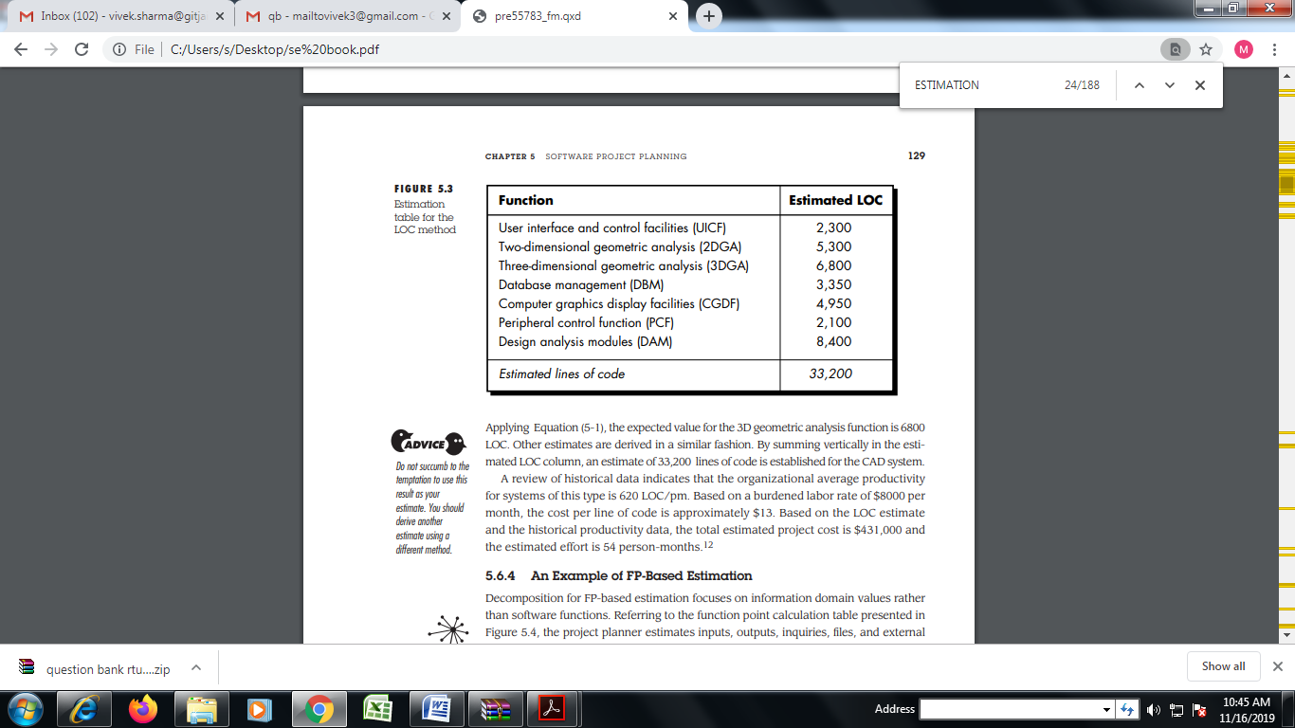
LOC-Based Estimation

Slide 73
Function point (FP)
Easily estimate the size of a software product directly from the problem specification.
This is in contrast to the LOC metric, where the size can be accurately determined only after the product has fully been developed.
The conceptual idea behind the function point metric is that the size of a software product is directly dependent on the number of different functions or features it supports.
A software product supporting many features would certainly be of larger size than a product with less number of features.

Slide 74
Each function when invoked reads some input data and transforms it to the corresponding output data.
In addition to the number of basic functions that a software performs, the size is also dependent on the number of files and the number of interfaces.

Slide 75
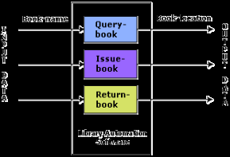
example
For example, the issue book feature of a Library Automation Software takes the name of the book as input and displays its location and the number of copies available. Thus, a computation of the number of input and the output data values to a system gives some indication of the number of functions supported by the system

Slide 76
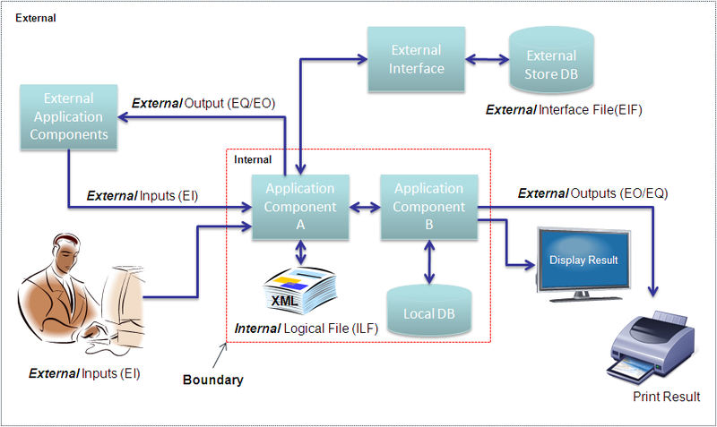
Function points (FP)

Slide 77
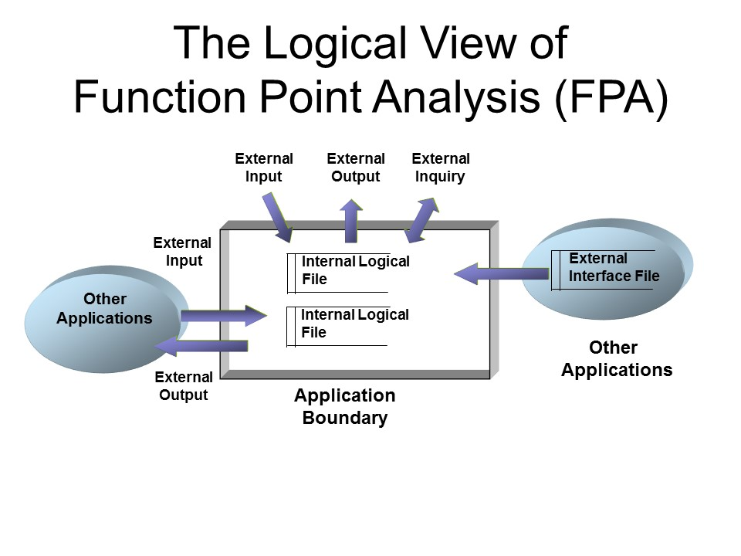

Slide 78
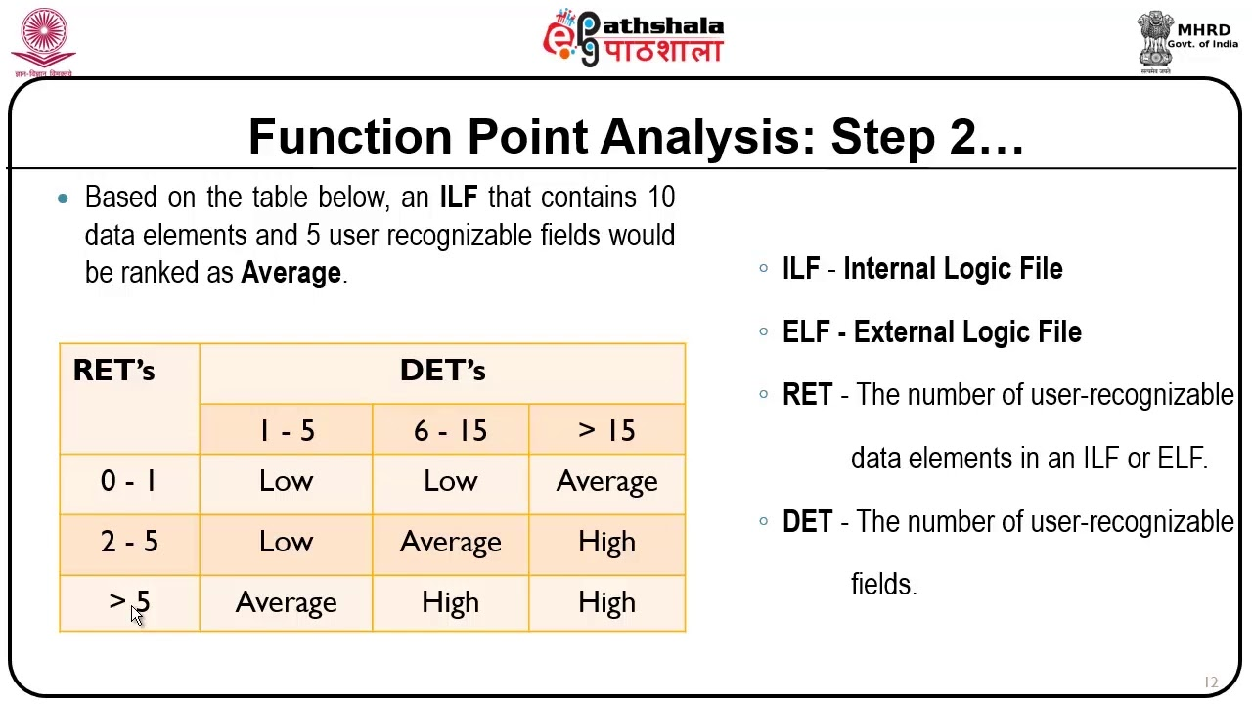

Slide 79
C0mputing Function Point (FP)
FP = Count-total * [0.65 + 0.01 *∑(F_{i})]
Function point is computed in two steps.
1. Compute the unadjusted function point (UFP)
2. Compute the Complexity Adjustment Factor(CAF)
Finally, FP=UFP*CAF.

Slide 80
Number of inputs:
Each data item input by the user is counted. Data inputs should be distinguished from user inquiries.
Inquiries are user commands such as print-account-balance. Inquiries are counted separately.
Individual data items input by the user are not considered in the calculation of the number of inputs, but a group of related inputs are considered as a single input.
For example, while entering the data concerning an employee to an employee pay roll software; the data items name, age, sex, address, phone number, etc. are together considered as a single input. All these data items can be considered to be related, since they pertain to a single employee

Slide 81
Number of outputs:
The outputs considered refer to reports printed, screen outputs, error messages produced, etc. While outputting the number of outputs the individual data items within a report are not considered, but a set of related data items is counted as one input.
Number of inquiries:
Number of inquiries is the number of distinct interactive queries which can be made by the users. These inquiries are the user commands which require specific action by the system.
Number of files:
Each logical file is counted. A logical file means groups of logically related data. Thus, logical files can be data structures or physical files.
Number of interfaces:
Here the interfaces considered are the interfaces used to exchange information with other systems. Examples of such interfaces are data files on tapes, disks, communication links with other systems etc.

Slide 82
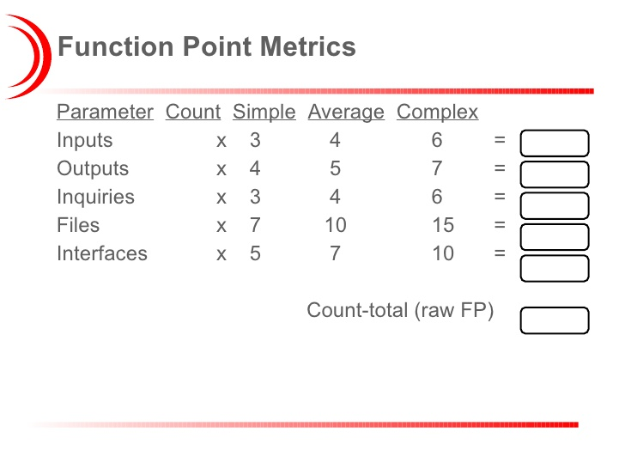
Compute the unadjusted function point (UFP)

Slide 83
Compute the Complexity Adjustment Factor (CAF)
CAF refines the UFP measure by considering fourteen other factors such as high transaction rates, throughput, and response time requirements, etc.
Each of these 14 factors is assigned from 0 (not present or no influence) to 5 (strong influence).
The resulting numbers are summed, yielding the total degree of influence i.e. ∑Fi
Now, CAF = (0.65+0.01* ∑Fi).
As ∑Fi can vary from 0 to 70, CAF can vary from 0.65 to 1.35.

Slide 84
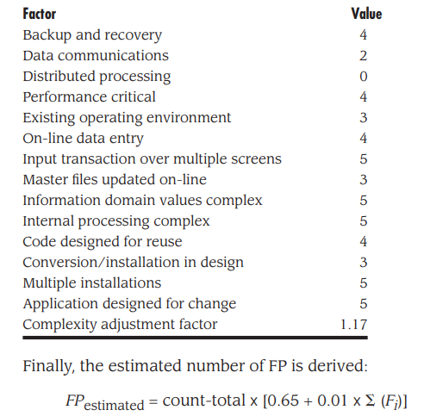
1
2
3
4
5
6
7
8
9
10
11
12
13
14
0
SUM = 46
CAF = [0.65+0.01*46]
=1.11
0
1.11

Slide 85
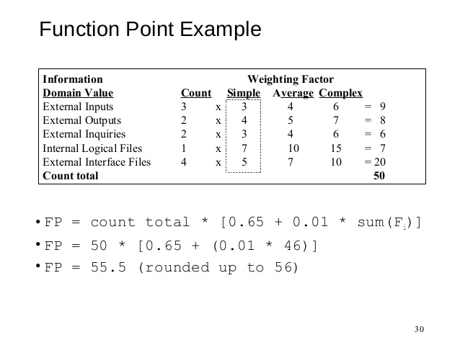

Slide 86
Example:
Q. Compute the function point, productivity, documentation, cost per function for the following data:
Number of user inputs = 24
Number of user outputs = 46
Number of inquiries = 8
Number of files = 4
Number of external interfaces = 2
Effort = 36.9 p-m
Technical documents = 265 pages
User documents = 122 pages
Cost = $7744/ month
Various processing complexity factors are: 4, 1, 0, 3, 3, 5, 4, 4, 3, 3, 2, 2, 4, 5.

Slide 87
Solution:
Measurement Parameter | Count | Weighing factor | Total
1. Number of external inputs (EI) | 24 | *4 | = 96
2. Number of external outputs (EO) | 46 | *4 | = 184
3. Number of external inquiries (EQ) | 8 | *6 | = 48
4. Number of internal files (ILF) | 4 | *10 | = 40
5. Number of external interfaces (EIF) | 2 | *5 | = 10
Count-total → 378

Slide 88
So sum of all f_{i} (i ← 1 to 14) = 4 + 1 + 0 + 3 + 5 + 4 + 4 + 3 + 3 + 2 + 2 + 4 + 5 = 43
FP = Count-total * [0.65 + 0.01 *∑(f_{i})] = 378 * [0.65 + 0.01 * 43] = 378 * [0.65 + 0.43] = 378 * 1.08
= 408

Slide 89


Total pages of documentation = technical document + user document = 265 + 122 = 387pages
Documentation = Pages of documentation/FP = 387/408 = 0.94

Slide 90
EFFORT ESTIMATION COCOMO ESTIMATION MODELS

Slide 91
Cocomo estimation model
Cost constructive model.
First introduced by Barry W. Boehm.
Most widely used software estimation model.
COCOMO predicts the efforts and schedule of a software project.
COCOMO is defined in terms of three different models:
– The Basic model,
– The Intermediate model, and
– The Detailed model.
The more complex models account for more factors that influence software projects, and make more accurate estimates.

Slide 92
The development mode
The most important factors contributing to a project's duration and cost is the Development Mode.
-Organic mode: The project is developed in a familiar,stable environment,and the project is similar to previously developed products.The product is relatively small,and requires the little innovation.
-Semidetached mode: The project's characteristics are intermediate between Organic and Embedded.
-Embedded mode: The project is characterized by tight, inflexible constraints and interface requirements. An embedded mode project will require a great deal of innovation.

Slide 93
Basic cocomo model
Computes software development effort (and cost) as function of program size expressed in estimated lines of code.
Model:
SOFTWARE PROJECTS | a | b | c | d
Organic | 2.4 | 1.05 | 2.5 | 0.38
Semi Detached | 3.0 | 1.12 | 2.5 | 0.35
Embedded | 3.6 | 1.20 | 2.5 | 0.32

Slide 94
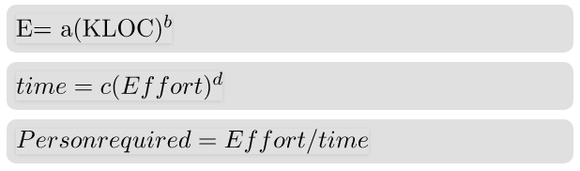
Basic cocomo equations
Where:
E is the Effort in person-months.
time is the development time in months.
kLOC is estimated number of lines of code.
Person required = Total No. of persons required to accomplish the project.

Slide 95
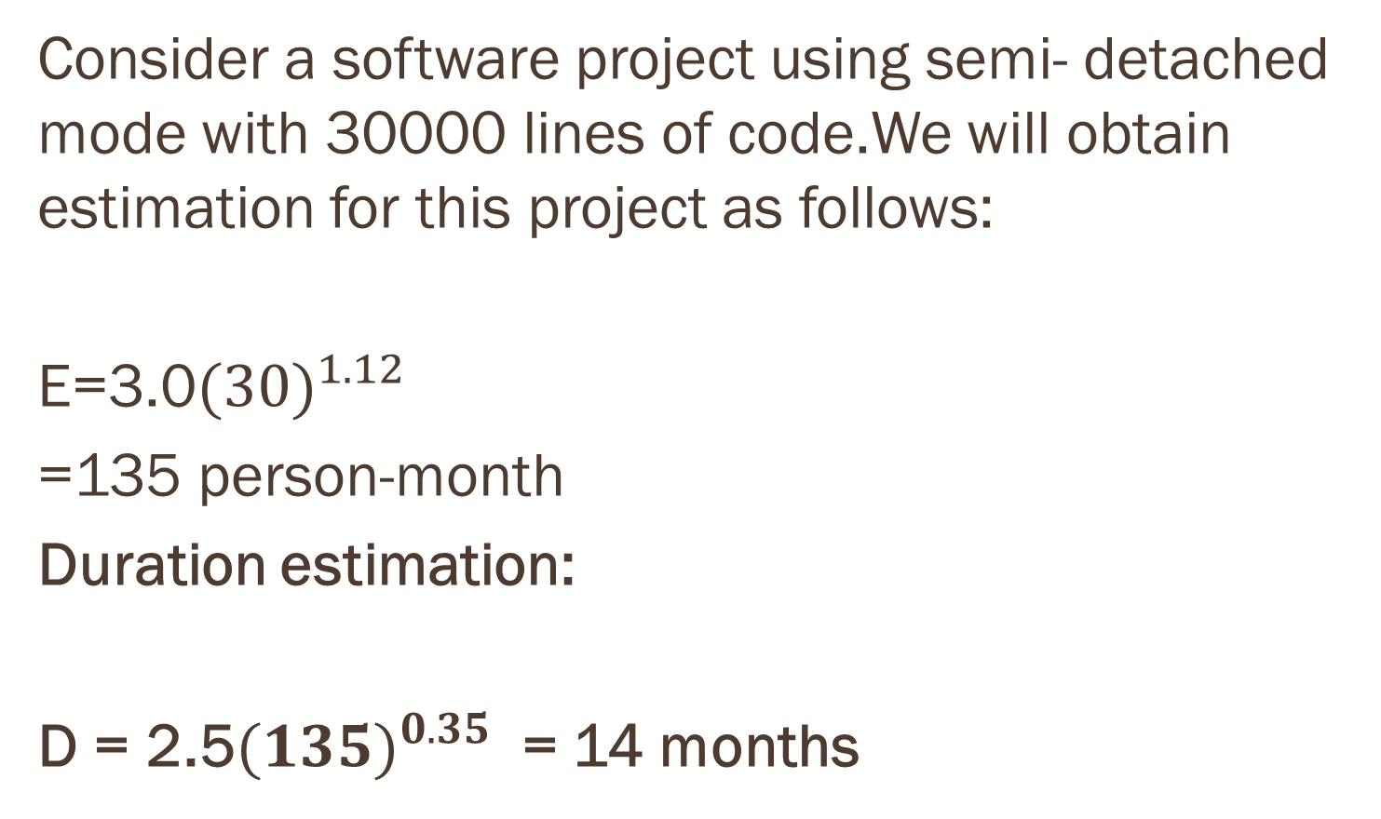


Example

Slide 96
Ex cont...
Person estimation:
P = E/D
=135/14
= 10 persons approximately.

Slide 97
Intermediate cocomo Model –
The basic COCOMO model assumes that the effort is only a function of the number of lines of code and some constants evaluated according to the different software system.
However, in reality, no system’s effort and schedule can be solely calculated on the basis of Lines of Code.
For that, various other factors are also responsible, such as reliability, experience, Capability.

Slide 98
These factors are known as Cost Drivers and the Intermediate Model utilizes 15 such drivers for cost estimation.
Classification of Cost Drivers and their attributes:
(i) Product attributes –
Required software reliability extent
Size of the application database
The complexity of the product
(ii) Hardware attributes –
Run-time performance constraints
Memory constraints
The volatility of the virtual machine environment
Required turnabout time

Slide 99
(iii) Personnel attributes –
Analyst capability
Software engineering capability
Applications experience
Virtual machine experience
Programming language experience
(iv) Project attributes –
Use of software tools
Application of software engineering methods
Required development schedule

Slide 100
COST DRIVERS | VERY LOW | LOW | NOMI-NAL | HIGH | VERY HIGH
1. Product Attributes
Required Software Reliability | 0.75 | 0.88 | 1.00 | 1.15 | 1.40
Size of Application Database |  | 0.94 | 1.00 | 1.08 | 1.16
Complexity of The Product | 0.70 | 0.85 | 1.00 | 1.15 | 1.30
2. Hardware Attributes
Runtime Performance Constraints |  |  | 1.00 | 1.11 | 1.30
Memory Constraints |  |  | 1.00 | 1.06 | 1.21
Volatility of the virtual machine environment |  | 0.87 | 1.00 | 1.15 | 1.30
Required turnabout time |  | 0.94 | 1.00 | 1.07 | 1.15

Slide 101
3. Personnel attributes
Analyst capability | 1.46 | 1.19 | 1.00 | 0.86 | 0.71
Applications experience | 1.29 | 1.13 | 1.00 | 0.91 | 0.82
Software engineer capability | 1.42 | 1.17 | 1.00 | 0.86 | 0.70
Virtual machine experience | 1.21 | 1.10 | 1.00 | 0.90
Programming language experience | 1.14 | 1.07 | 1.00 | 0.95
4. Project Attributes
Application of software engineering methods | 1.24 | 1.10 | 1.00 | 0.91 | 0.82
Use of software tools | 1.24 | 1.10 | 1.00 | 0.91 | 0.83
Required development schedule | 1.23 | 1.08 | 1.00 | 1.04 | 1.10

Slide 102
Project manager is to rate these 15 different parameters for a particular project on a scale of one to three.
Then, depending on these ratings, appropriate cost driver values are taken from the above table.
These 15 values are then multiplied to calculate the EAF (Effort Adjustment Factor).

Slide 103
The Intermediate COCOMO formula now takes the form:
The product of all effort multipliers results in an effort adjustment factor (EAF). Typical values for EAF range from 0.9 to 1.4.
The values of a and b in case of the intermediate model are as follows:
SOFTWARE PROJECTS | a | b
Organic | 3.2 | 1.05
Semi Detached | 3.0 | 1.12
Embedded | 2.8 | 1.20

Slide 104
Detailed Model
Detailed COCOMO includes all characteristics of the intermediate version with an assessment of the cost driver’s impact on each step of the software engineering process.
The detailed model uses different effort multipliers for each cost driver attribute. In detailed COCOMO, the whole software is divided into different modules and then we apply COCOMO in different modules to estimate effort and then sum the effort.

Slide 105
The Six phases of detailed COCOMO are:
Planning and requirements
System design
Detailed design
Module code and test
Integration and test
Cost Constructive model
The effort is calculated as a function of program size and a set of cost drivers are given according to each phase of the software lifecycle.

Slide 106
RISK ANALYSIS

Slide 107
RISK ANALYSIS
The probability of any unwanted incident is defined as Risk.
In Software Engineering, risk analysis is the process of identifying the risks in applications or software that you built and prioritizing them to take care of.
After that, the process of assigning the level of risk is done.
The categorization of the risks takes place, hence, the impact of the risk is calculated.

Slide 108
We will study this topic in detail including these points:
Why use Risk Analysis?
Risk Identification
Risk Assessment
Perspective of Risk Assessment
How to perform Risk Analysis?

Slide 109
Why use Risk Analysis?
In any software, using risk analysis at the beginning of a project highlights the potential problem areas.
After knowing about the risk areas, it helps the developers and managers to mitigate the risks.
Possible risk areas that you could encounter, here is a list:
Use of new hardware
Use of new technology
Use of new automation tool
The sequence of code
Availability of test resources for the application

Slide 110
certain risks that are unavoidable
There are certain risks that are unavoidable:
The time that you allocated for testing
A defect leakage due to the complexity or size of the application
Urgency from the clients to deliver the project
Incomplete requirements
In such cases, Following points can be taken care of:
Conduct Risk Assessment review meeting
Use maximum resources to work on high-risk areas
Create a Risk Assessment database for future use
Identify and notice the risk magnitude indicators: high, medium, low.

Slide 111
Risk Identification
There are different sets of risks included in the risk identification process. Those are as follows:
Business Risks: This risk is the most common risk associated with our topic. It is the risk that may come from your company or your customer, not from your project.
Testing Risks: You should be well acquainted with the platform you are working on, along with the software testing tools being used.
Premature Release Risk: a fair amount of knowledge to analyze the risk associated with releasing unsatisfactory or untested software is required
Software Risks: You should be well versed with the risks associated with the software development process.

Slide 112
Risk Assessment
This step is important, complex and should be tackled with the utmost care. There are three perspectives of Risk Assessment:
Effect – To assess risk by Effect. Identify a condition, event or action and try to determine its impact.
Cause – To assess risk by Cause is opposite of by Effect. Initialize scanning the problem and reach to the point that could be the most probable reason behind that.
Likelihood – To assess risk by Likelihood is to say that there is a probability that a requirement won’t be satisfied.

Slide 113
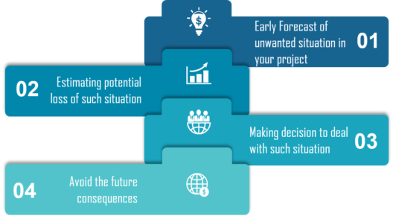
Steps in risk assessment

Slide 114
How to perform Risk Analysis?
There are three steps to perform risk analysis:
Searching the risk: Identification of possible areas where some unwanted problems or situations may occur.
Analyzing the impact of each individual risk: Assessment of the probability, reasons and results of risks (as if they really become real).
Measures for the risk identified: Consider the countermeasures or actions to be taken to stop or prevent the risks from happening (occurring those unwanted events in real) or Mitigating ( try to minimize) the effects of risks if they are unavoidable.

Slide 115
software project scheduling

Slide 116
Software project scheduling
So What is scheduling first?
Is an important part of project planning activity.
It involves deciding which tasks would be taken up when.
Why scheduling?
The majority of projects are 'completed' late, if at all.
A project schedule is required to ensure that required project commitments are met.
A schedule is required to track progress toward achieving these commitments.

Slide 117
Why software is delieverd late?
An unrealistic deadline.
Changing but unpredicted customer requirements.
Underestimation of efforts needed.
Risks not considered at the project start Unforeseen technical difficulties .
Unforeseen human difficulties Miscommunication among project staff.
Failure to recognize that project is falling behind schedule.

Slide 118
Project scheduling
“One Day at a Time”
All technical projects involve hundreds of small tasks.
Some tasks do not effect the project completion.
Other tasks are critical for the project completion.

Slide 119
Project scheduling cont...
To schedule the project, a project manager must do the following:
Define all project tasks.
Build a network that depicts their interdependence.
Identify the critical tasks.
Track the progress of these tasks.
Recognize the delay “one day at a time”.

Slide 120
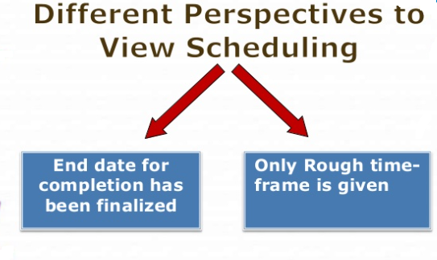

Slide 121
Basic principle of software project scheduling
Compartmentalization – define distinct tasks. Interdependency- parallel and sequential tasks.
Time allocation - assigned person days, start time, ending time.
Effort validation - be sure resources are available.
Defined responsibilities — people must be assigned.
Defined Outcomes- each task must have an output.
Defined milestones - review for quality.

Slide 122
THANK YOU!

